Slide 1
Asymptotic Analysis
Design and Analysis of Algorithms (CS2009) Fall 2023
Abeeda Akram

Slide 2
How does the algorithm behave as the problem size gets very large?
Running time
Memory/storage requirements
Bandwidth/power requirements/logic gates

Slide 3
Time complexity Analysis
Time complexity analysis for an algorithm is independent of programming language, and machine.
Objectives of time complexity analysis is:
To determine the feasibility of an algorithm by estimating an upper bound on the amount of work performed
To compare different algorithms before deciding, which one to implement
T(n) is usually very complicated so we need an approximation of T(n)….close to T(n).
This measure of efficiency or approximation of T(n) is called ASYMPTOTIC COMPLEXITY or ASYMPTOTIC ALGORITHM ANALYSIS

Slide 4
Asymptotic Analysis
Is a way of expressing the running time of an algorithm, using idealized units of computational work.
Time is not in numbers of seconds or any such time unit.
It represents number of operations that are carried out while executing the algorithm.
Depends on Input Data
Provides the best, average and the worst running times of an algorithm.

Slide 5
Big-O Notation
Is a formal method of expressing the upper bound of an algorithm's running time.
The longest amount of time, it could possibly take for the algorithm to complete.
For non-negative functions, f(n) and g(n),
if there exists an integer no and a constant c > 0, such that for all integers n ≥ n0 , f(n) ≤ cg(n), then f(n) is Big O of g(n).
This is denoted as "f(n) = O(g(n))".
c.g(n)
f(n)
t
n
no

Slide 6
From Function to Notation
f(n) = 2n + 3 → O(n)
h(n) = 2n² + 2n + 3 → O(n²)
Constants are ignored
Terms growing faster, dominate

Slide 7
From Function to Notation
f(n) = 4n⁴ + 2n² + 2n + 3 → O(n⁴)
f(n) = 4n⁴ + 2^{n} + 3 → ?
Which term grows rapidly with growing input?
Constants are ignored
Terms growing faster, dominate

Slide 8
Example: Big-O
Formula: for n >= n₀ , f(n) <= cg(n)
f(n) = 2n + 3
g(n) = (n)
find c and n₀
n | f (n ) | c g(n)
 |  | c = 2 | c = 3
1 | 5 | 2 | 3
2 | 7 | 4 | 6
3 | 9 | 6 | 9
4 | 11 | 8 | 12
3.n
2n+3
t
n
3
Answer : c=3, n₀ = 3

Slide 9
Big-Ω omega Notation
Is a formal method of expressing the lower bound of an algorithm's running time.
The smallest amount of time, it could possibly take for the algorithm to complete.
For non-negative functions, f(n) and g(n),
if there exists an integer no and a constant c > 0, such that for all integers n ≥ n0 , f(n) ≥ cg(n), then f(n) is Big Ω of g(n).
This is denoted as "f(n) = Ω(g(n))".
f(n)
c.g(n)
t
n
no

Slide 10
Example: Big-Ω omega
Formula: for n >= n₀ , f(n) >= cg(n)
f(n) = 2n + 3
g(n) = (n)
find c and n₀
2n+3
2.n
t
n
no

Slide 11
Big-θ theta Notation
This is basically saying that the function, f(n) is bounded both from the top and bottom by the same function, g(n).
For non-negative functions, f(n) and g(n), f(n) is theta of g(n) if there exists an integer no and a constants c1 > 0 and c2>0,
such that c1g(n) ≤ f(n) ≤ c2g(n) for all n ≥ n0
iff f(n) = O(g(n)) and f(n) = Ω(g(n)).
This is denoted as "f(n) = Θ(g(n))".
c2.g(n)
f(n)
c1.g(n)
t
n
no

Slide 12
Example: Big-θ theta
f(n) = 2n + 3
g(n) = (n)
find c and n₀
3.n
2n+3
2.n
t
n
3

Slide 13
Common Functions
O(1) constant / bounded time
O(log_{b}n) = O(lgn) logarithmic time
O(n) linear
O(n log_{b}n) n log n
O(n²) quadratic
O(n³) cubic
O(n^{k}) polynomial
O(2^{n}) exponential
O(n!) factorial

Slide 14
Relative Growth of functions
n | lgn | nlgn | n^2 | n^3 | 2^n
1 | 0 | 0 | 1 | 1 | 2
2 | 1 | 2 | 4 | 8 | 4
4 | 2 | 8 | 16 | 64 | 16
8 | 3 | 24 | 64 | 512 | 256
16 | 4 | 64 | 256 | 4096 | 65536
32 | 5 | 160 | 1024 | 32768 | 4294967296
64 | 6 | 384 | 4096 | 262144 | 1.84467E+19
128 | 7 | 896 | 16384 | 2097152 | 3.40282E+38
256 | 8 | 2048 | 65536 | 16777216 | 1.15792E+77
512 | 9 | 4608 | 262144 | 134217728 | 1.3408E+154

Slide 15
Time
Input

Slide 16
Properties of Big-O
If f(n) = O(g(n)) and g(n) = O(h(n)) then f(n) = O(h(n))
If f(n) = O(g(n)) and h(n) = O(g(n)) then f(n) + h(n) = O(g(n))
n^{k} = O(n^{(k+j)}) for any positive j
If f(n) is polynomial of degree k then f(n) = θ(n^{k} )
if f1(n) = O(g(n)) and f2(n) = O( h(n)) then f1(n) + f2(n) = O(max (g(n), h(n))
log^{k}(n) = O(n) for any constant k

Slide 17
Calculating T(n)
Declaration of variables (int, bool, void, private, ...) (0 unit)
Assignment (=) ( 1 unit)
    Assignment = <exp> depends on total operations
Basic operations ( 1 unit)
    Arithmetic (+, -, /, *, %)
    Logical (&&, ||, !)
    Relational Operations (==, !=, <, <=, >, >=)
    Indexing in array a[0]
    Follow an object reference
Jump Statements (return, break, goto, continue) ( 1 unit)
Function invocation
    Without parameters fun(); ( 1 unit)
    With parameters fun(a, b, …); pass by value add cost of each assignment
Memory Management (new, delete, sizeof) ( 1 unit)
    If call constructors or destructor then add their cost

Slide 18
Calculating T(n)
If-else
  Cost of <exp> + select block with largest cost
    if (<exp>)
      <Statement 1>
    else
      <Statement 2>
Switch
  Cost of <exp> + largest cost of all statements
    Switch(<exp>){
        Case condition 1: <statement 1>
        Case condition 2: <statement 2>
        …
        default : <statement >
      }

Slide 19
Calculating T(n)
Loops
  Cost of <exp> + calculate the cost of block and number of iterations
    while(<exp>)
    for (<int s1>;<exp>; <exp>)
    do
          <Statement 1>
        while(<exp>);

Slide 20
Simple Loops
Rule 0 : The condition that stops a loop executes ONE MORE time than the loop itself (the last time is when it is evaluated false)
Rule 1: Anything inside the loop will run approximately n/k times
    for(i=1;i<=n;i=i+k)
    for(i=n;i>=1;i=i-k)
    while(i<=n){ i=i+k; }
    while(n>=1){ n=n-k; }
If k = 1, then n/1 = O(n)
If k = 2, then n/2 = O(n)

Slide 21
Simple Loops
Rule 2: Anything inside the loop will run approximately log_{k}n times
    for(i=1; i<=n; i=i*k)
    for(i=n; i>=1; i=i/k)
    while(n>=1) { n=n/k;}
    while(i<=n) { i=i*k;}
If k = 2, then log2(n) = O(log2(n))
If k = 20, then log20(n) = O(log20(n))

Slide 22
Independent Nested Loops
  Rule 3
  the number of iterations of the inner loop are independent of any variable controlled in the outer loop.
Total times a statement inside a nested loop executed is equal to the product of the times the individual loops run
    for (i=1;i<=n;++i)
    for (j=1;j<=m;++j)
A statement inside the above nested loop will run n*m times
Values of i | 1 | 2 | 3 | … | n
Number of Iterations of Inner Loop | m | m | m | m | m
Total Number of times the loops are executed | m+ m+ m+ m ... = n*m

Slide 23
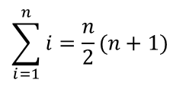
Dependent Nested Loops
  Rule 4
  the number of iterations of the inner loop are dependent upon some variable controlled in the outer loop.
    for(i=1;i<=n;++i)
    for (j=1;j<=i;++j)
  This nested loop approximately runs ½ n(n+1) times. The variable j depends upon the value of i.
Values of i | 1 | 2 | 3 | … | n
Number of Iterations of Inner Loop | 1 | 2 | 3 | … | i
Total Number of times the body of the inner loop is executed | 1+2+3+4….n Arithmetic series: = O(n^2)
$$\sum_{i=1}^{n}{i}=\frac{n}{2}(n+1)$$

Slide 24
Dependent Nested Loops
  Rule 5
  the number of iterations of the inner loop are dependent upon some variable controlled in the outer loop.
    for(i=1;i<=n;i=i*2)
    for (j=0;j<i;++j)
  This nested loop approximately runs (2n) times. The variable j depends upon the value of i.
Values of i | 1 | 2 | 4 | 8 | … | n
Number of Iterations of Inner Loop | 1 = 2^0 | 2= 2^1 | 4= 2^2 | 8= 2^3 | … | N = 2^k K = log(n )
Total Number of times the body of the inner loop is executed | 2^0+ 2^1+ 2^2+ …+ 2^k = (2^k+1 )- 1 = 2.2^k +1 = O(2^k) = O(n)

Slide 25
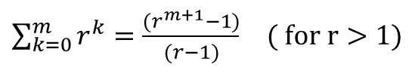

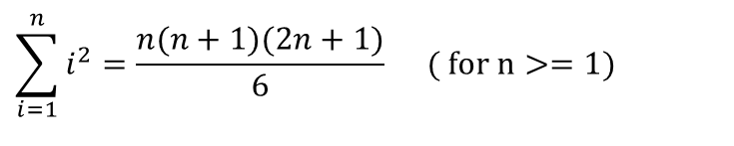
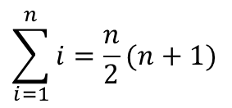
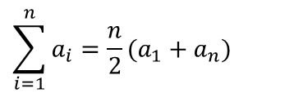
Some Useful Formulae
Logarithms:
Arithmetic Sums:
Geometric Sums:
$$\sum_{i=1}^{n}{a_{i}}=\frac{n}{2}(a_{1}+a_{n})$$
$$\sum_{i=1}^{n}{i}=\frac{n}{2}(n+1)$$
$$\sum_{i=1}^{n}{i^{2}}=\frac{n(n+1)(2n+1)}{6} ( \text{for} \text{n}>=1)$$
$\sum_{k=0}^{m}{r^{k}}=\frac{ 1−r^{m+1}}{1−r}$ $( \text{for} \text{r}<1)$
$\sum_{k=0}^{m}{r^{k}}=\frac{(r^{m+1}−1)}{(r−1)}$ $( \text{for} \text{r}>1)$

Slide 26
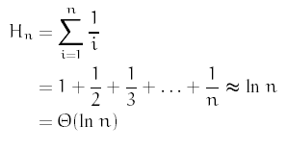
Some Useful Formulae
Harmonic series For n ≥ 0

